Slide 2

Next-generation cluster management architecture and software
LA-UR-18-30725
Towards Continuous Uptime
Paul Peltz Jr. and Lowell Wofford
11/11/2018
Operated by Los Alamos National Security, LLC for the U.S. Department of Energy's NNSA

Slide 3
Current Issues
Current Cluster Management Tools
Centralized
Monolithic
Proprietary/Outdated
Not Configuration Management and Orchestration capable
Downtime
Binary Network Topologies (Up/Down)
Updates/Patches
Schedulers
Lack integration into the cluster management
Inference model only

Slide 4
How do we solve these problems?
Current Cluster Management Tools
Complete redesign necessary
Distributed State Engine, Modular
Downtime
System should never go down
Degraded modes
Distributed Services
Rolling Upgrades
CI/CD of Patches and Changes
Schedulers
Ties directly into the distributed state engine

Slide 5
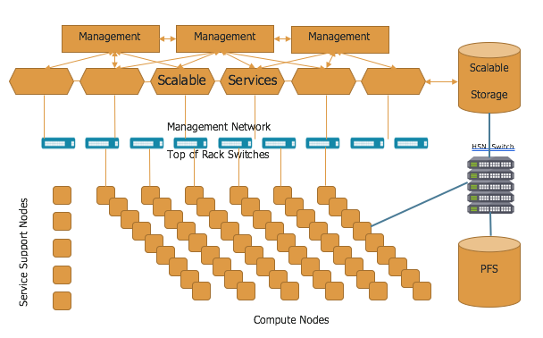
Redesign of HPC Architecture

Slide 6
How we will test and deploy changes in the future
Build Server
Gitlab
Config Mgmt
Master
Master
Master
Sub-Master
Sub-Master
Sub-Master

Slide 7
Stage 1 – Functional Testing
Build Server
Gitlab
Config Mgmt
OBS
Git
CM
Master
Master
Master
Sub-Master
Sub-Master
Sub-Master

Slide 8
Stage 2 – Small Scale Test
Build Server
Gitlab
Config Mgmt
OBS
Git
CM
Master
Master
Master
Sub-Master
Sub-Master
Sub-Master

Slide 9
Stage 3 Scale Testing
Build Server
Gitlab
Config Mgmt
OBS
Git
CM
Master
Master
Master
Sub-Master
Sub-Master
Sub-Master

Slide 10
Stage 4 – Update Additional Master/Sub-Master
Build Server
Gitlab
Config Mgmt
OBS
Git
CM
Master
Master
Master
Sub-Master
Sub-Master
Sub-Master

Slide 11
Final Stage – Continue to reboot nodes into new images once jobs complete
Build Server
Gitlab
Config Mgmt
OBS
Git
CM
Master
Master
Master
Sub-Master
Sub-Master
Sub-Master

Slide 12
Sounds great, how do we do this?
Service decentralization
HA is not acceptable
VMs/Micro Services
Migrate services
Distributed State Engine
The cluster manager must be able to track state, transitions, and final states of the system including the service nodes.
Backwards compatible APIs
Need at least one version compatibility between service APIs.
Scheduler Integration
Must be able to schedule the transition of release states on the system
Handle A/B configuration if there are compatibility issues

Slide 13
Automated and Continuous Testing!
Continuous Testing
Testing first on development systems (TDS)
Automated testing for functionality and performance during each stage of deployment
Once release is approved that branch is released into production
Configuration management notifies state engine to begin rolling through upgrade
Testing is performed for each step
If a test exception occurs, human intervention will be required to resolve the issue
Roll forward or roll back support

Slide 14
Kraken is a State Engine for System Automation
It can: boot systems, load images, recover from failures… and more.
Kraken tracks two kinds of state:
What state are we in? (“Discoverable”)
What state should we be in? (“Configuration”)
Kraken knows how to mutate from the state you’re in to the state you want:
Maintains a directed graph of known state mutations (e.g. power_off -> power_on)
Searches the graph to create a chain of mutations to get from where we are to where we want to be.
Simplified mutation graph for booting a node through traditional PXE. Edges are mutations, boxes are states.

Slide 15
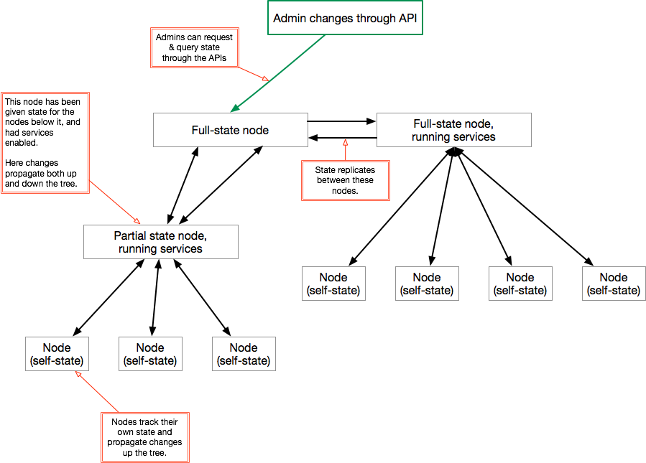
Kraken is Distributed
Kraken uses a protobuf-based, light-weight datagram protocol to synchronize state across the system.
This uses an eventual consistency model to converge on synchronized state.
Discoverable state migrates up the tree from the end-point nodes (computes).
Configuration state migrates down the tree from the master, or “full-state node.”
Sideways replication
is future work.

Slide 16
Kraken is Modular
Modules make kraken actually do work.
The core of Kraken:
State management
Plugin/Extension management
Modules can:
Instantiate microservices
Declare that they can mutate state
Declare that they can discover state
Extensions add new variables to the state

Slide 17
State of the Kraken
Basic set of functional microservices & plugins
Can boot multiple architectures
Uses layered container images in reference implementation
Open source (BSD-3):
https://github.com/hpc/kraken
Working towards first full release

Slide 18
Thanks!

